Slide 1

Data Analysis
---- Fifa 18/19 dataset
Group 2 – Member
Sushma Gadepally 001493153
Komal Matam 001877039
Zichao Tian 001465014
Sayli Bhutkar 001427569

Slide 2

Contents
01
04
Introduction
Evaluation
02
05
Data Description
Conclusion
03
Modeling

Slide 3
Overview -- Analytical Approach
Analytical Approach
We will be utilizing data about the player attributes from combining Fifa2018 and Fifa2019 . Our team will be making use of analysis mainly on the different player attributes to search for existing values in the data. Along with a graphical approach, we plan to utilize the techniques learnt in the classroom to manipulate the data and explain those findings in a sophisticated way.
Large amount of associated data
Get a high accuracy prediction
Overview
Performing merge on the data sets using ID we arrived at 12539 unique rows. Only the 2018 columns (64 columns excluding value and wage) were included with Value column from 2019 dataset that gave us a total of 70 features.

Slide 4

Data Description
Player personal attributes
Player performance attributes
Player preferred position and ratings at positions.
Data Observation
Data Feature Selection
Data Preparation

Slide 5
Part 2
Data Observation
Data Import
First Table Selection
Fifa18.csv
Fifa19.csv
→NewFifa.csv
2. Data analysis
Distribution
Anomalies
Outliers
Missing values
Incorrect values

Slide 6
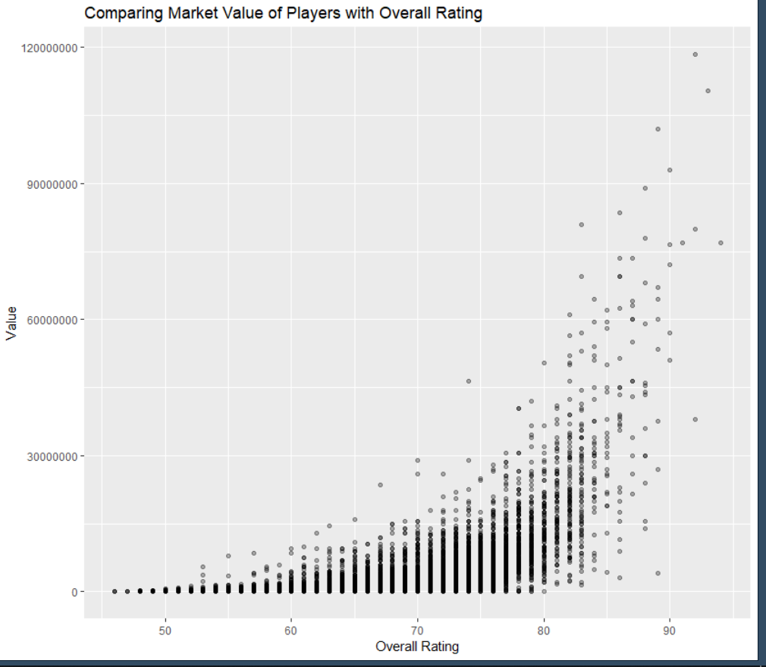
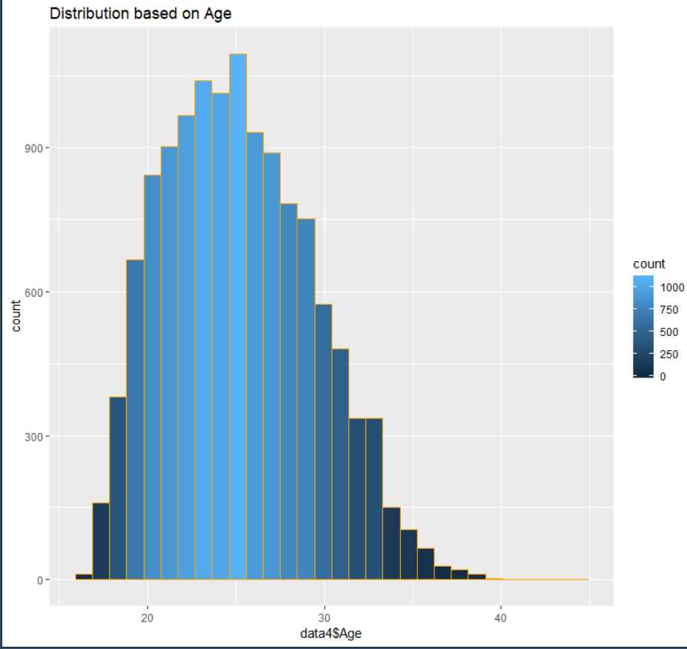
Part 2
Data Observation

Slide 7
Part 2
Data Cleaning
Data Preparation
Merge Data combining Fifa18 & Fifa19 by column ”ID”
Write new Csv file and then delete irrelative columns like “Photo”, etc.
Changed the categorical values to numeric for Nationality, Club, Preferred positions columns.
Convert values like “N/A” to zero; Cleaning of Value field;
Cleaned numerical functions

Slide 8
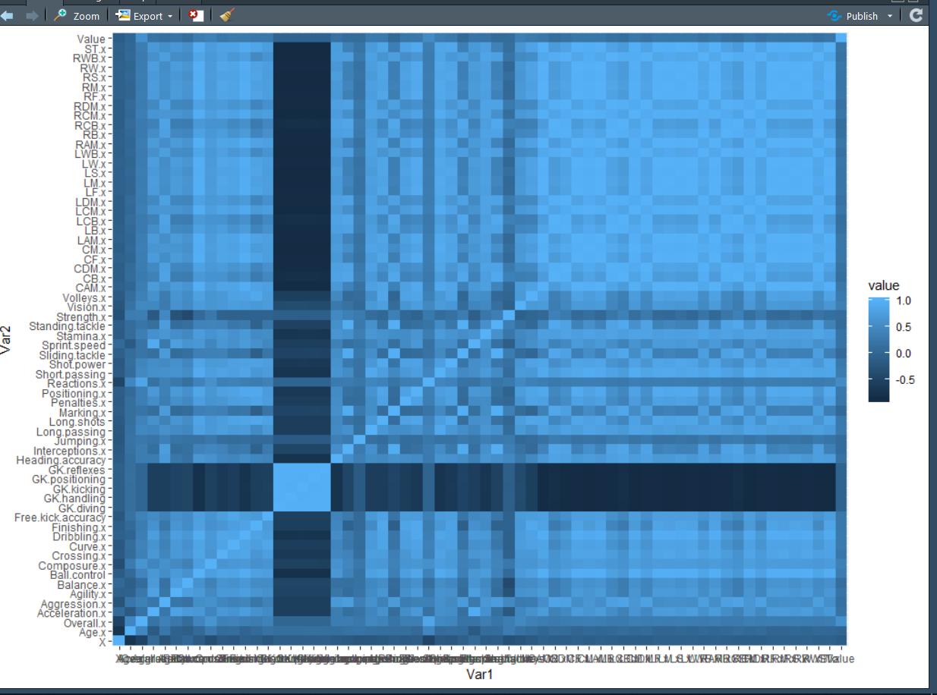
Part 2
Feature Selection
Using correlation matrix and p value as feature selection techniques.
To summarize a large amount of data where the goal is to see patterns. In our example above, the observable pattern is that all the variables highly correlate with each other.

Slide 9
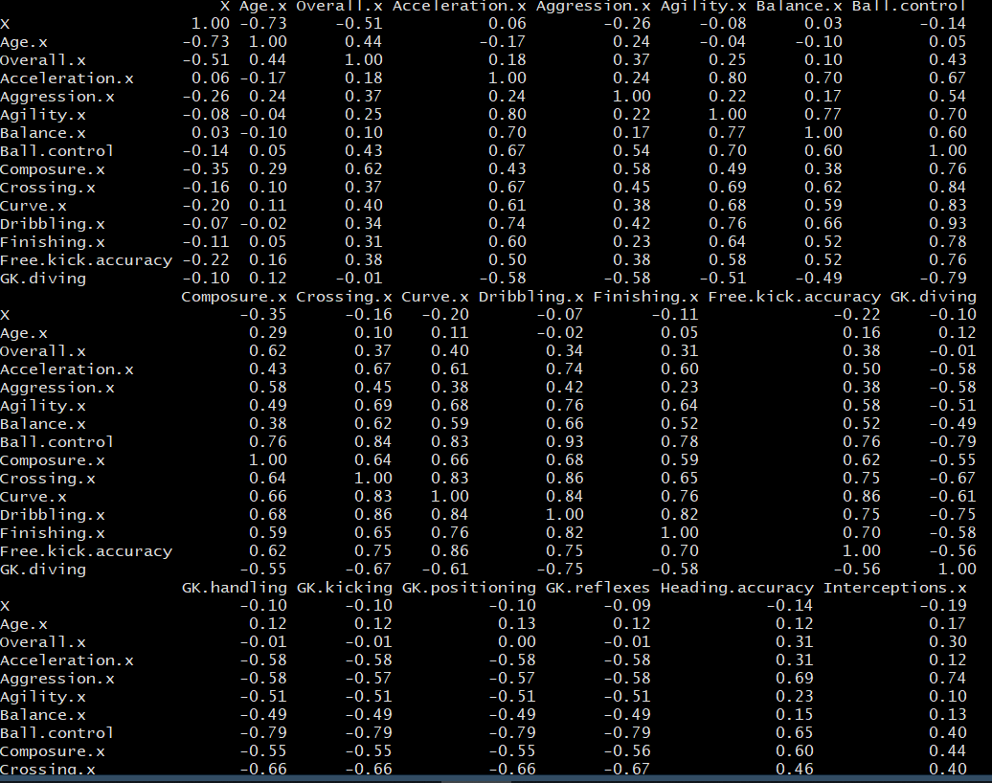
The generated Correlation Matrix for our dataset

Slide 10
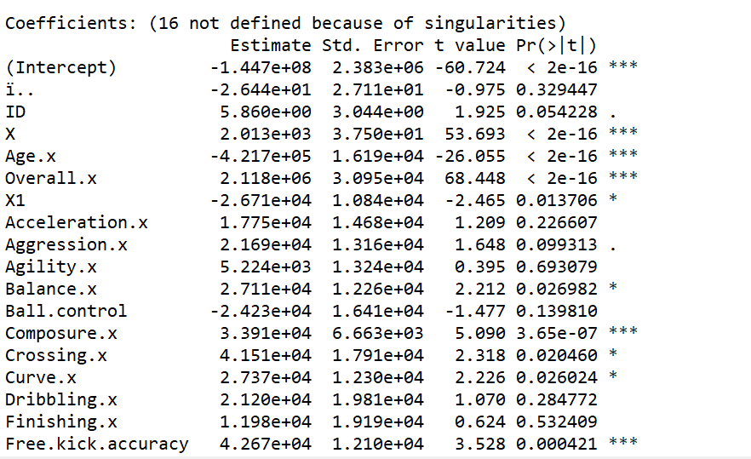
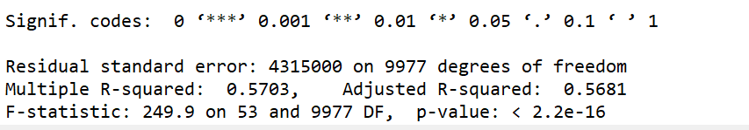
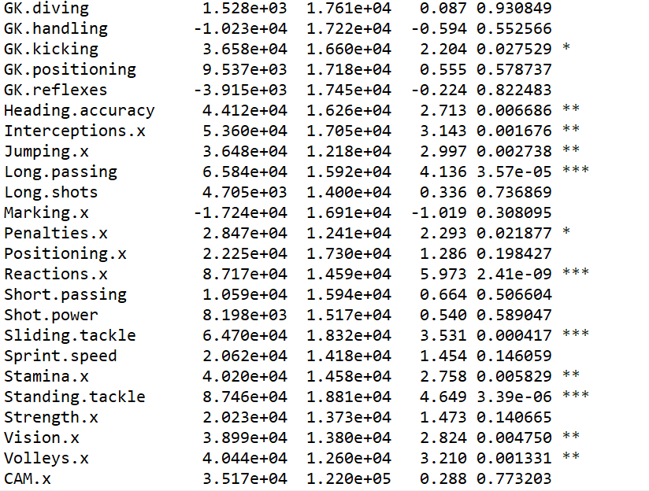
P Value
Explanation:
Selected features with the least p Value

Slide 11
Modeling
Linear Regression
Decision Tree
Random Forest
XGBoost
A
B
C
D

Slide 12
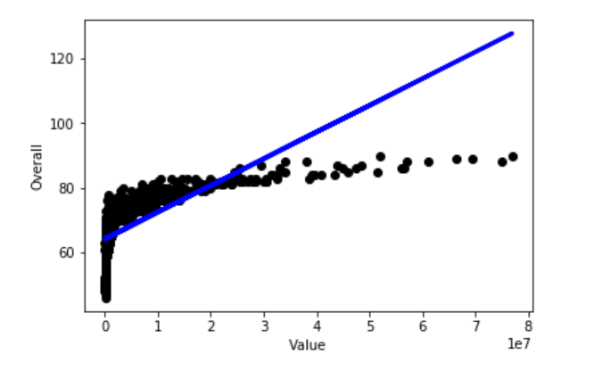
Modeling
Linear Regression
Linear regression is a linear approach to modelling the relationship between a dependent variable and one or more independent variables. It has two types: Simple Linear Regression and Multiple Linear Regression.
RMSE Calculated over Mean= 1.26

Slide 13
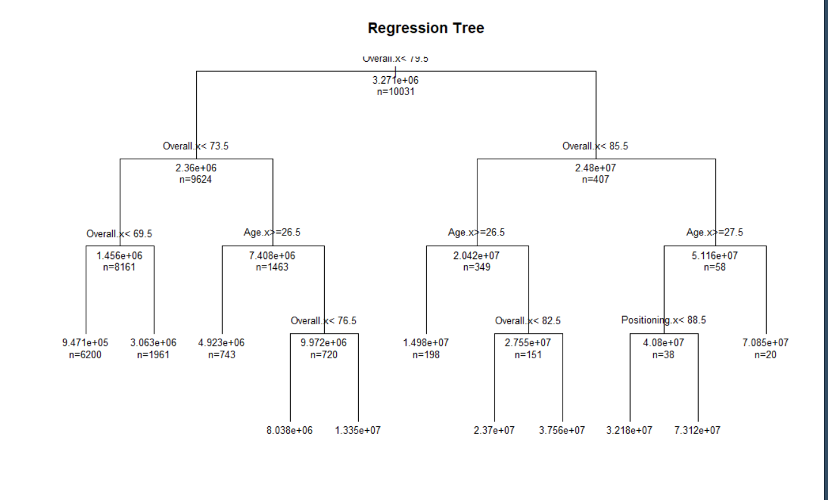
Modeling
Decision Tree
Decision tree is a predictive model to go from observations about an item which are represented in the branches to conclusions about the item's target value which are represented in the leaves.
RMSE Calculated over Mean= 1.03

Slide 14
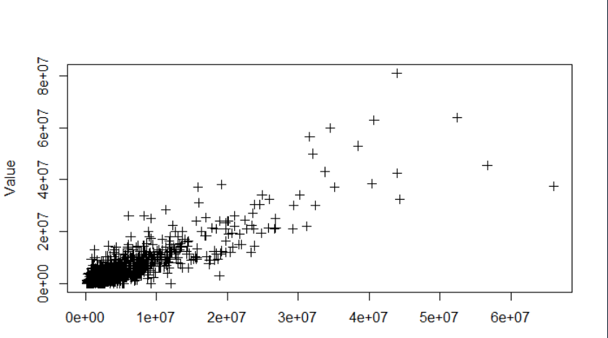
Modeling
Random Forest
Random forest builds multiple decision trees and merges them together to get a more accurate and stable prediction.
RMSE Calculated
over Mean= 0.81

Slide 15
Modeling
XGBoost
XGBoost is an implementation of gradient boosted decision trees designed for speed and performance.
Pushes the limit of computations resources for boosted tree algorithms.
RMSE Calculated over Mean= 0.83

Slide 16

Evaluation

Slide 17
Modeling
Without Feature Selection
 | Linear Regression | Decision Tree | Random Forest | XGBoost
RMSE (Over mean) | 2.3 | 0.97 | 0.81 | 0.83
R Square | 0.34 | 0.53
With Feature Selection based on p Value
 | Linear Regression | Decision Tree | Random Forest | XGBoost
RMSE (Over mean) | 1.26 | 1.03 | 0.81 | 0.80
R Square | 0.567 | 0.5
With Feature Selection based on Correlation Matrix
 | Linear Regression | Decision Tree | Random Forest | XGBoost
RMSE (Over mean) | 2.2 | 0.97 | 0.85 | 0.81
R Square | 0.34 | 0.4

Slide 18
Conclusion
Final model and its parameters and performance
data.frame': 10031 obs. of 13 variables:
$ X : int 3330 4666 7182 11386 2529 11261 11840 8282 7884 775 ...
$ Age.x : int 29 26 20 23 25 19 29 19 22 32 ...
$ Agility.x : int 75 31 77 38 72 27 56 77 50 62 ...
$ Balance.x : int 78 33 77 28 69 27 55 81 51 72 ...
$ Composure.x : int 46 44 59 29 77 27 45 49 23 77 ...
$ GK.reflexes : int 16 74 7 52 10 60 12 14 74 7 ...
$ Jumping.x : int 59 73 64 50 71 37 57 67 60 60 ...
$ Reactions.x : int 64 53 63 57 67 48 52 53 67 76 ...
$ Sprint.speed: int 83 38 84 39 73 21 59 65 39 83 ...
$ Strength.x : int 43 74 65 43 77 58 67 48 63 78 ...
$ Vision.x : int 44 41 52 42 65 22 46 57 41 65 ...
$ ST.x : int 60 0 64 0 73 0 45 50 0 59 ...

Slide 19

Thanks.
Presented By
Sushma Gadepally 001493153
Komal Matam 001877039
Zichao Tian 001465014
Sayli Bhutkar 001427569

